Slide 1
Hydra Integration Platform
Implementation & Testing
Junjie Tang
Salim J.M.

Slide 2
Overview
Integration Process
Input
Output
Control

Slide 3
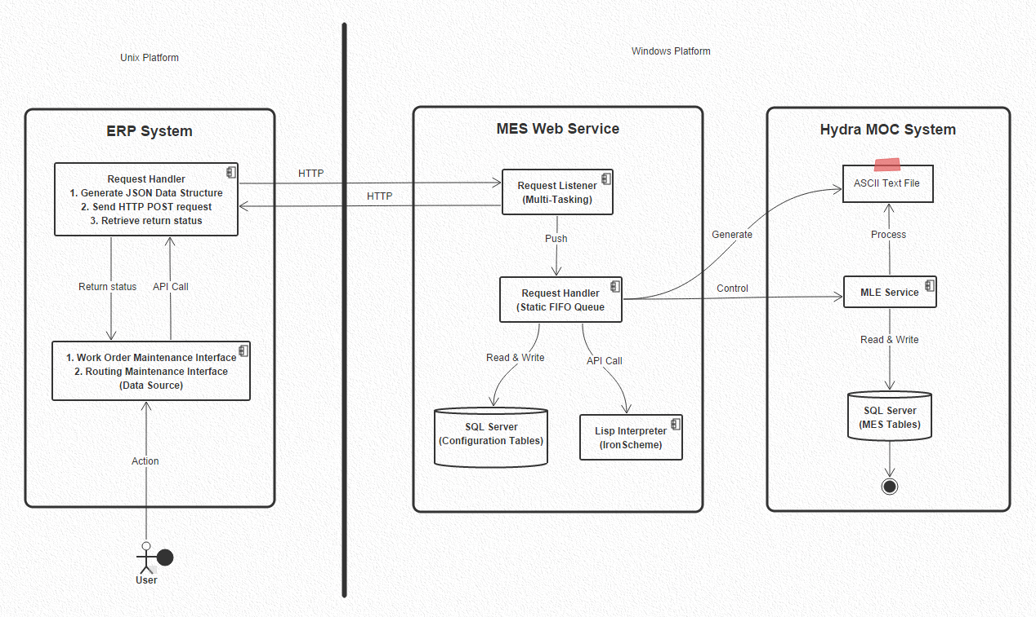
Architecture

Slide 4
Process Input – Data Structure & Rules
Process input or request data structure
2 vectors : Data Before & Data After
Multi-records
Each record should start with a Sync Key
All the fields constituting the Business key should succeed the Sync Key and precede any other field
To send an insert trigger, Data Before vector should be empty
To send a delete trigger, Data After should be empty
Sending “T” record should only be encoded in Data Before
JSON (JavaScript Object Notation)
It is a lightweight data-interchange format.
It is easy for humans to read and write.
It is easy for machines to parse and generate.
It is based on a subset of the JavaScript Programming Language.
JSON is a text format that is completely language independent but uses conventions that are familiar to programmers of the C-family of languages.
These properties make JSON an ideal data-interchange language.

Slide 5
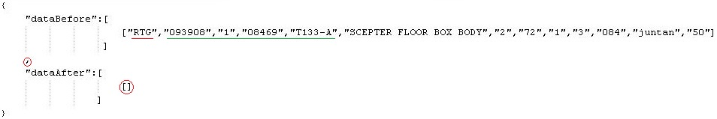
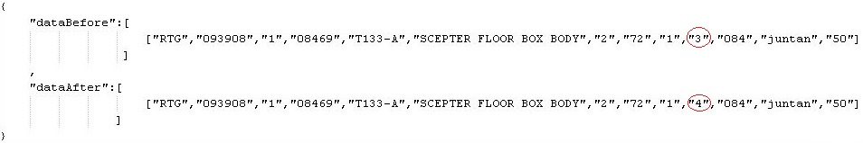
Process Input – Request Examples
Ex 1 : One Record Delete
Ex 2 : One Record Update

Slide 6
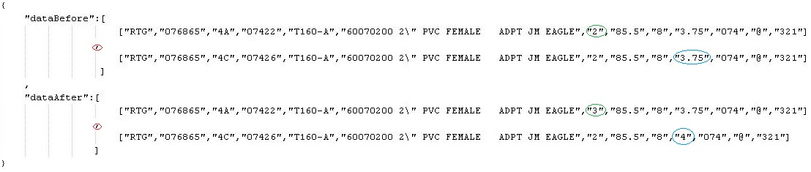
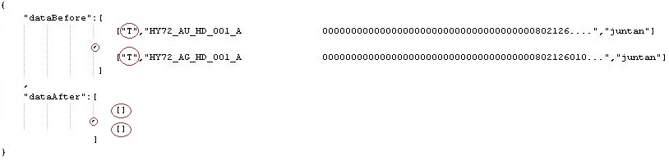
Process Input – Request Examples
Ex 3 : Two Record Update
Ex 4 : Two “T” Records

Slide 7
Process Input – Configuration Tables
Exist in “hydra_DataTransfer” database
7 tables total
Main ones are :
Sync :
Hold the definition for a synchronisation type
Master key : all configuration are retrieved by this key.
Process start by checking the existence of the input key in this table.
Sync Entry
Define how the Request Matrix should be structured
Sync Action
List all the action (generated BAPIs) depending on the business rules

Slide 8
Process Input – Configuration Tables

Slide 9
Process Input – Configuration Tables

Slide 10
Process Input – Configuration Tables
Acronym
Define how a BAPI dialog should be generated
Holds all the needed output fields by “Sync Object”
Tells the BLL how the values of these fields should be calculated
En rapport with the Entry Matrix fields
Using the configuration defined in the fields : Boiler Plate and Transform Type
Transform Type
C : Constant
Boiler Plate Value is the Exact desired output
V : Entry Matrix Value
Boiler Plate Value is the position of the field in the Entry Matrix
Boiler Plate Position should always be preceded by number sign (#)
E : Evaluate → Call LISP
Boiler Plate is a LISP expression and its results would be the output
Text should be Double Quoted (“”)
Entry Matrix Value should also be preceded by number sign (#)

Slide 11
Process Input – Configuration Tables
Acronym
LISP
Formula engine to evaluate expression : Mathematical or Text etc.
List C# engine is embedded in the Web Service BLL
Save a lot of time in Programming
Make the Web Service fulfill all the future Business needs (scalability)
Currently 2 LISP functions are used :
Multiply → Syntax : (* f1 f2)
String Concatenation → Syntax : (string-append “f1” f2”)
Ex1 : (* #7 1000) → Multiply Position 7 in Entry Matrix (Cycle Time is sec) by 1 thousand
Ex2 : (string-append "Mold Base " "#10" "-" "#4") → Concatenate Mold Base with Position 10 in Entry Matrix (Warehouse) and a dash and Position 4 in Entry Matrix (Mold Code)

Slide 12
Process – Main Functions
Web Service Request Controller
Queue
Controls All the Process
Operate concurrent users cases
JSON Parser
Deserialize JSON file
Check the integrity of Json

Slide 13
Process – Main Functions
Web Service Request Handler
Business Logic
Generate BAPI dialog according the configuration
MLE Handling
Write dialog text file
Restart MLE Service
SQL Server
SQL Logging
Document the Work of the Web Service
Establish a link with MLE transactions

Slide 14
Process – Output
JSON file
BAPI file
Log file
Trace File

Slide 15
Hydra Integration Platform
Process Testing
Junjie Tang
Salim J.M.

Slide 16
Scenario 0 – Transportation of WOs
Test 0 : 2 “T” records
Record 1 : Order Data
MLE Segment : HY72_AU_HD_001_A
Work Order No. : 0000802126 at Machine 08469
Record 2 : Operation Data
MLE Segment : HY72_AG_HD_001_A
Operation No. : 0000802126010

Slide 17
Scenario 1 – One Routing @ One Time
Test 1 : Deleting One Routing : No New Data→ 1 Dialog
Test 2 : Inserting One Routing : No Old Data → 3 Dialogs
Test 3 : Updating One Routing : Non-Key Change → 1 Dialog
Test 4 : Replacing One Routing : Key Change → 4 Dialogs

Slide 18
Scenario 2 – Two Records @ One Time
Test 5 : Updating 2 Routing : Non-Key Change → (2X1) 2 Dialogs
Record 1 : (076865, 07422, T160-A)
Update Primary Flag from 2 to 3
Record 2 : (076865, 07426, T160-A)
Update Setup Time from 3h45min to 4h
Test 6 : Replacing 2 Routings : Key Change → (2X4) 8 Dialogs
Record 1 : (076865, 07422, T160-A)
Replace by (076865, 07422, T160-Z)
Record 2 : (076865, 07426, T160-A)
Replace by (076865, 07426, T160-X)
Test 7 : Reverting back to Test 5 : Key Change → (2X4) 8 Dialogs
Record 1 : (076865, 07422, T160-Z)
Replace by (076865, 07422, T160-A)
Record 2 : (076865, 07426, T160-X)
Replace by (076865, 07426, T160-A)

Slide 19
Scenario 2 – Two Records @ One Time
3 Multi-record Vectors

Slide 20
Scenario 3 – 8 Records @ One Time
Test 8 : One large vector contains 15 Dialogs

Slide 21
Scenario 4 – Stress Test
Source : Infoflo Test Program
Send Test 8 (Big Matrix) 200 Times using a loop
Average Time per Request 1.5 second

Slide 22
Scenario 5 – Error Handling Test
BLL Error
Give LISP a bad configuration

